Slide 1

Oracle Database Migration To Azure Cloud Database Platform
May 2019

Slide 2


AGENDA
About Pactera Edge
Partnership
PaaS Market Overview
What We do
Why Azure PaaS and Benefit?
Benefits of PaaS across different protagonists
Challenges with On-premise Database Infrastructures
Features of Azure SQL DB
Azure SQL- Everything Built In
Preparedness Check
DB Migration
Assessment
Plan
Migrate
Validate
Manage and Monitor

Slide 3

PACTERA IS A GLOBAL TECHNOLOGY SERVICES COMPANY THAT DESIGNS, BUILDS AND OPTIMIZES DIGITAL APPLICATIONS, PRODUCTS AND PLATFORMS.

Slide 4

FACTS + FIGURES
33
30k
100
+
+
Global
Offices
Employees
Fortune 500
Clients

Slide 5


THE VALUE WE BRING
DOUBLE-AXIS VALUE PROPOSITION
RUN FASTER
Achieve new levels of performance to reduce cost and improve operational efficiency.
RUN DIFFERENT
New digital business capabilities to drive relevance, revenue & growth.

Slide 6


OUR CORE PHILOSOPHY
SUCCESSFUL ENTERPRISE + CUSTOMER-FACING APPLICATIONS
INTELLIGENCE + HUMAN CENTRIC EXPERIENCE DESIGN
MODERN ARCHITECTURE + ROBUST DEVELOPMENT CAPABILITIES

Slide 7
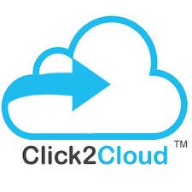




PARTNERSHIPS- THEIR ASKS
Click2Connect
CoreStack
Ingram Micro
Microsoft Data & AI Team, Hyderabad
Affluent
Resourcing for Cloud App development
Mobility, Content and Data Management
Digital Transformation
Application and Infrastructure
Data and AI
Complete Cloud Lifecycle
Assessment, Infrastructure recommendation, implementation, migration, analytics, reporting and cost optimization
Multi cloud management
Most powerful Cloud commerce Engine
Hyperscale Digital Platform & Infrastructure Management
Go-to-Market Support and Resources
Cloud Operations
Compliance
Cost and Consumption Management
OK to white-label their tools for Pactera GTM
Cloud Infrastructure
IoT and Hybrid Cloud
Artificial Intelligence
Business Intelligence
Capabilities
Data Governance
Data Security
IoT
Migration Activities – Technical scope to be performed by C2C and Pactera will be taking care of the Governance
Data Governance
Data Security
Integrating their data-governance practice
Revenue Sharing on Commercial Cloud sales
Will offer discounts for Pvt. Cloud and Public cloud purchases
Best for Acquia like Build-Operate-Transfer kind of deals
Building of Engineering like teams who work on Microsoft’s clients in technologies of MS BI an MS tools of AI & ML
Pactera’s POV
Joint GTM
Resourcing plan 3-months in advance for IoT
Visibility in advanced level of discussions with the prospects
Joint GTM
Introduction to the Strategic Mgmt. and Hunter teams
Investments for joint campaigns
Joint GTM
Investment into joint platform creation for Alibaba Cloud & IoT
Investments to run the sandboxes at our own costs
Joint GTM
Exposure to the current deal pipeline of Public cloud consumptions
Investments to run joint-campaigns
A steady supply of Resources for – SSIS, SSRS, SSAS, AI/ML with certifications
No investment asks
PARTNER
ASKS

Slide 8
PaaS Market Overview
Need to covert with good Shape
Database and application platform services represent the largest market segments, with blockchain, digital experience, serverless and artificial intelligence/machine learning (AI/ML) platform services as the newest.
The total PaaS market revenue is forecast to reach $20 billion in 2019, and to exceed $34 billion in 2022, according to the latest forecast from Gartner.
PaaS accounts for approximately 24% of all enterprise workloads (up from 14% in 2016)
Enterprise IT spending for cloud-based offerings will surpass spending for noncloud IT offerings by 2022, according to Gartner
IaaS is hovering around 12% (up from 6%).
PaaS is currently the most popular model, hovering around 32% and expected to grow in 2020.
By 2026, the revenue of vendors offering platforms-as-a-service in the public cloud market is predicted to reach a combined value of 68.3 billion U.S. dollars.”

Slide 9
WHAT WE DO

Slide 10

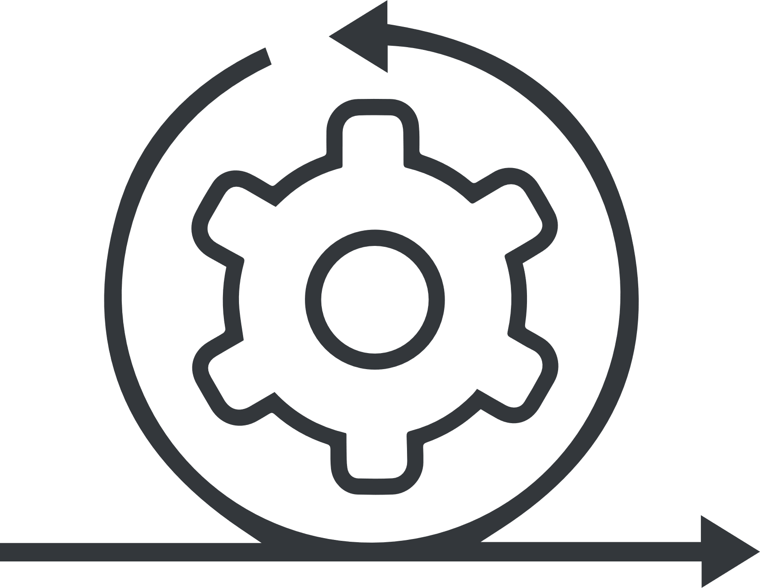






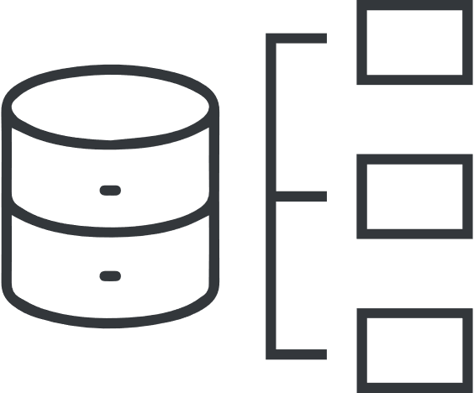
FROM IDEATION TO IMPLEMENTATION
Design Thinking + Lean Innovation to quickly ideate, design, prototype and test the right solution.
Best Practice Waterfall and Agile approach to platform development, across multiple languages and software packages.
STRATEGIZE
IDEATE + DESIGN
ARCHITECT
DEVELOP
OPERATE + OPTIMIZE
Research, Strategy and Functional Analysis to understand Current State and Envision Opportunities.
Definition of Technology and Data Architecture to support envisioned solution.
Maintenance and Data-Driven Optimization Services (including DevOps) for continuous business value extraction.

Slide 11
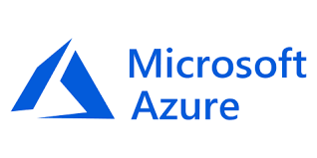
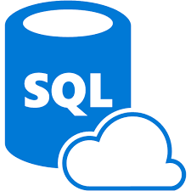
Need to covert with good Shape
WHAT WE DO: Enterprise DB and Application
Existing DB and Apps On-premise
Migration
Cloud Optimized
Manage
App
modernized
Lift & Shift Minimal Code-changes
Architected for the Cloud
Modernize/Refactor/Rewrite
Azure SQL

Slide 12
PROVEN E2E MIGRATION AND DELIVERY APPROACH
Planning
Management Oversight
Communication
Product Management
Resource Planning
Release Model
Product Team
War Room
Release Meeting
Team Meetings, Teleconferences
Task Tracking
Email, email, email
Feature Requirements
Development
Dev Test
Strategic Requirements MRD, PRD
Revenue Requirements
Quality / Infrastructure Projects
Specification
Plan
Design/Review
Code/Review
Unit Test
Integration / Release
Tests
Sanity
Regression
Functional
Stress
Performance
Deployment
…
Build Cycle
RIs / Branch Management
Bug Status
Release Convergence
Support Requirements
Maintenance
Customer Issues
Revenue Requirements
Design
Code
Unit Test
Beta Tests
Deployment Planning
Performance Analysis
Infrastructure and Tools
Source Control
Specifications
Source
Test Plans
Test Repository
Test Status Reports
Product Documentation
Bug Database
Project Status - Intranet

Slide 13
FLEXIBLE ENGAGEMENT MODELS
Our teams adapt to your ways of working.
Consulting Engagements
Project Based Efforts
Center of Excellence
Collaborative Augmentation
Decision Dashes
Design Sprints
Transformation Consulting – People, Process, Platforms
Time & Materials
Fixed Fee
Yearly Contract
Dedicated Team for Projects, Staffing, AdHoc Initiatives
Individual Roles + Skillsets
Based on Hourly Rate Card

Slide 14
Need to covert with good Shape with Icons
Why Azure PaaS ? PaaS Benefit
Pay as you go Method
Speed, Flexibility and Agility
Scalability and Performance
No backup overheads
High Network Bandwidth
Remote working
Zero software maintenance
Notes:
Pay as you go method:- Users only pay for the services procured, so there is not any wastage of resources. Pay-as-you-go method permits you to be charged only for what you use. Some PaaS providers charge monthly fee to access their platform and the apps. It is important to discuss pricing before engaging their services.
Speed, Flexibility and Agility:- PaaS provides better flexibility, speed, and agility to the development process. By providing a predictable, application infrastructure, enterprises don’t get bogged down with enabling applications and can meet the customers’ e needs.
3. Scalability and Performance:- Cloud can be scaled to meet your growing IT system requirements.Regarding performance, it is the PaaS provider’s responsibility to ensure that customers’ services run without any hurdle and, also to provide them with the ability to access their resources via dashboards for better performance.
4. No backup overheads:- Storage spaces and backups require costs for maintenance, power, and cooling, which all drain a company’s budget. These are not required with PaaS solutions, as PaaS eliminates the need for backup and storage. It will ultimately result in substantial savings.
5. High Network bandwidth:- It’s very important for deployment process of a web app to perform testing to see how it performs in different frameworks. It often results in a network-wide slowdown, but with PaaS, the entire process of testing can be done on the cloud computing servers.
6. Remote working:- This is one of the biggest advantages provided by platform as a service in cloud computing. What all you need -an internet connection and a web browser, through which developers can work together across several locations anytime, on the same application build.
7. Zero software maintenance:- PaaS in cloud computing provides all the management and upgrades of both hardware and software, so that the users can focus only on their business.

Slide 15



Benefits of PaaS across different protagonists
CIO/CXO/C-Suite Executives
Data Analyst
Data Scientist
Data Engineer
Focus to build Core Foundational framework.
Data Consolidation & data availability improvement
Empowering Analytics & spend less time on lift & transformation.
Modular approach to acquire data from all data points
Execute Intelligent ML/DL algorithms
Couple data with right tools-driving both predictive & prescriptive outcomes
Performance
Scalability
Maintainability
Design for Portability ensuring serverless – ETL architecture with no bottleneck
Enablement of evolving technologies.
Re-imagine the current-state systems to handle & derive faster insights.
Modernize data management
Extend self-service, predictive analytics & visualization.
Streamline data exchange in hybrid IT environments.

Slide 16
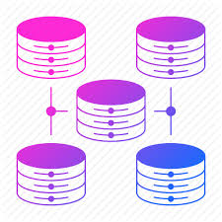
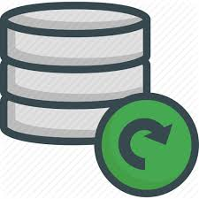
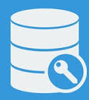



Challenges with On-premise Database Infrastructures
Need to covert with good Shape
In order to keep the on-premise database infrastructures in a healthy state, there are many challenges:
Scalability
Latest Features
Employee Access
Patch Management
Access to Cloud Services
Partner/Vendor Access:
Notes:
Scalability: On-premise database infrastructures can only scale up to the size of their hardware infrastructure. If additional scalability is necessary, you need to scale up or scale out. What if you scale up too much?
Patch Management: It is necessary to make sure that all updates are applied to the platform in a timely manner.
Latest Features: On-premise database infrastructures would not have all the latest features and capabilities. It would be necessary to upgrade the platform to the latest version in order to gain access to these new features
Access to Cloud Services: On-premise database infrastructures would not make the most out of the Cloud Service offerings.
Employee Access: Employees have access to the database infrastructure only while on-premise
Partner/Vendor Access:With on-premise database infrastructures, it is difficult to provide access to your Platform to partners and vendors.

Slide 17
Need to covert with good Shape
Features of Azure SQL Database
Azure SQL Database offers the following benefits:
Built-in intelligence (machine learning) that learns and adapts to your app
On-demand database provisioning
Managed Instance
A range of offers, for all workloads
99.99% availability SLA, zero maintenance
Geo-replication and restore services for data protection
Azure SQL Database Point in Time Restore feature
Advance Security
Monitoring and tuning
Managed Instance in Azure SQL Database has the following characteristics:
Security isolation through Azure Virtual Network
Application surface compatibility, with these features:
SQL Server Agent and SQL Server Profiler
Cross-database references and queries, SQL CLR, replication, change data capture (CDC), and Service Broker
Database sizes up to 35 TB
Minimum-downtime migration, with these features:
Azure Database Migration Service
Native backup and restore, and log shipping

Slide 18
Azure SQL Database – Everything built-in
Need to covert with good Shape
The intelligent relational cloud database service
Intelligent performance
Scales on the fly
Business continuity
Works in your environment
Advanced threat protection
Realize automatic performance improvements from continuous assessment and innovation
Change service tiers, performance levels, and storage dynamically without downtime
Easily manage and monitor business critical functions for reliable operations
Develop your app and connect to SQL Database with the tools and platforms you prefer
Build security-enhanced apps with built-in protection and industry-leading compliance
Notes:
Objective: This slide is intended to break down the features and services of Azure SQL Database.
Talking Points:
Scales on the fly - Scale performance anytime, anywhere, without app downtime
When demand for your app grows from a handful of devices and customers to millions, SQL Database is the database service that can scale along with you—on the fly and with no app downtime.
Business Continuity – Easily manages and monitor your business critical functions
Your mission critical applications are core to your business and their uptime and performance are critical to successfully deploying them to Azure. Azure SQL Database has all the critical features to ensure business continuity built in and deployed in seconds.
Learns and adapts – Learn and adapt dynamically with your app
As your app runs, Azure SQL Database continuously learns your unique app patterns, adaptively tunes your performance, and automatically improves reliability and data protection—freeing you to focus on your app.
Works with your environment - Work within your preferred development environments
Develop your app with the tools and platforms you prefer. Microsoft Azure SQL Database make it easy to connect to SQL Database with a variety of technologies enabling you to focus on developing business logic and apps using tools you are familiar with.
Protects and secures – Help protect and secure your app data
Build security-enhanced apps in the cloud with built-in data protection, high availability, and security features—without implementing custom code. With physical and operational security built in to Azure, SQL Database can help you meet the most stringent regulatory compliances.
Recover from disaster
Reduce the impact of a disaster on your business. Using azure tools for business continuity to ensure that your data is resilient from disaster. With automated backups and active geo-replication in up to four secondary readable locations you can be sure that your data is safe. Using failover groups ensures that during a outage in one location a secondary location can automatically can take over and ensure minimum outage time.

Slide 19

Preparedness Check

Slide 20
Need to covert with good Shape
Are you prepared?
Customer Checklist:
Pactera Checklist:
1 | Business Owner Identified? (Customer Sponsorship)
2 | Business Value Identified (The Why?)
3 | Corp Cloud team-IT blessed? (Frictionless)
4 | Security and Compliance blessed? (Key to Production)
5 | Cost out versus Tech Stack? (Budget identified?
1 | Ensure “right” solution (Engaged your Cloud architect)
2 | Are you teamed with your MSFT Account Team?
3 | “Help” programs identified (DWR resource, CIF etc.)
4 | Purchasing vehicle identified? (Production Path?)

Slide 21
DB Migration
What’s driving Migrations?
Suitable situations
Targets
Steps for Migration
Assess | Plan | Migrate | Validate | Manage

Slide 22
What’s driving Migrations?
Need to covert with good Shape
Software and hardware refresh
Security threats
(e.g., Spectre)
Urgent capacity needs
Compliance
(e.g., GDPR)
Quickly integrate acquisitions
Application innovation, delivering applications faster
Migration triggers
Software end of support (e.g., VMware, Windows Server, SQL Server)
Datacenter contracts expiry
Notes:
Convergence of migration triggers/catalysts [including outsourced datacenter contract expirations, integrating acquisitions, urgent capacity needs, software and hardware refresh, end of support, security threats (e.g., Spectre), compliance (e.g., GDPR), need to deliver applications faster]

Slide 23
Assessment
Grey out tab in every mother slide
System Architecture
Discover and Inventory
Check database compatibility
2. Database Information
3. Application Information
3. Overall system Demands
4. Business Dependencies
5. Impact analysis
6. Calculate precise TCO for Azure
Active
Noactive

Slide 24




Assessment
Need to covert with good Shape colour icons
Database
Schema
Tables
Synonyms
Sequences
Views
Partitions
Packages
Procedures
Functions
Triggers
UDT
Application queries
Dynamic PL/SQL
Roles
Users
Resources
Jobs
Schedules
Chains
Events
Object
Programmability
Security
Scheduler

Slide 25
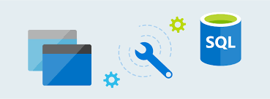
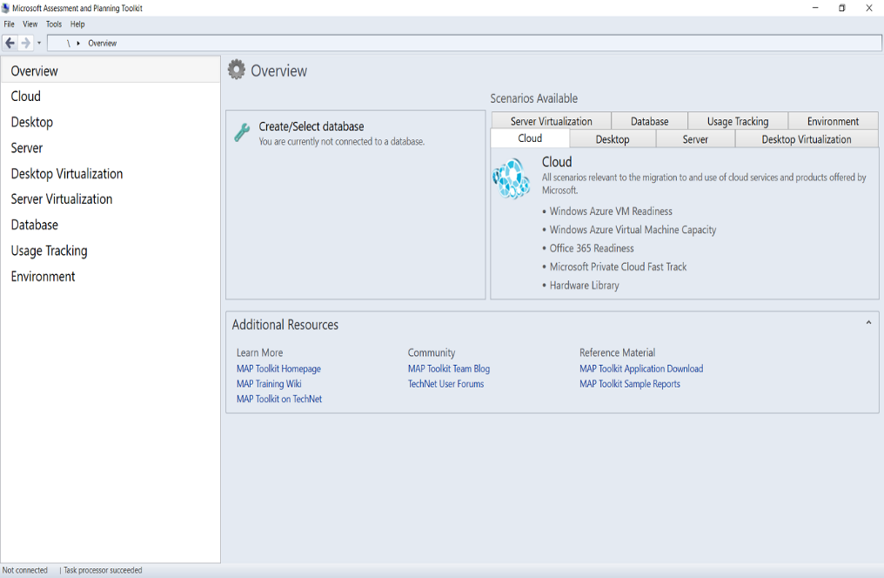
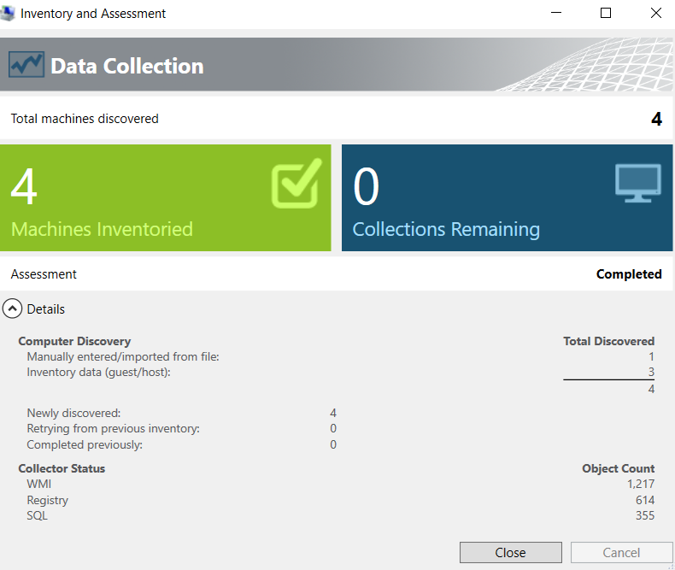
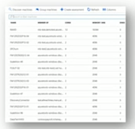
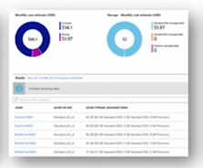
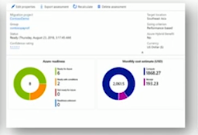
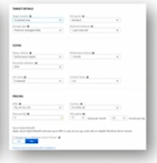
Assessment Tool Name
MAP Toolkit
2. Data Migration Assistant/SSMA
Database
Schema
Tables
Synonyms
Sequences
Views
Partitions
Assess your on-premises database by using the Data Migration Assistant.
Migrate the sample schema by using the Data Migration Assistant.
Create an instance of the Azure Database Migration Service.
Create a migration project by using the Azure Database Migration Service.
Run the migration.
Monitor the migration.
Download a migration report.
3. Azure Migrate
Agentless
Discovery
TCO
Calculator
Right
Sizing
All on
Azure
Seamless integration of Migration accelerators
Notes:
Map Tool
https://blogs.technet.microsoft.com/mapblog/2012/01/03/using-the-map-toolkit-to-discover-sql-server-across-the-enterprise/

Slide 26
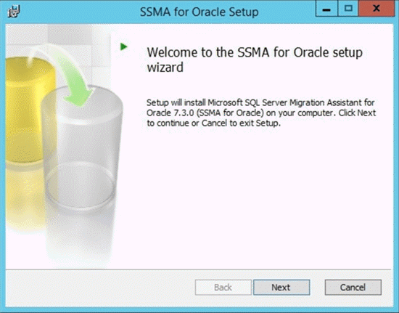
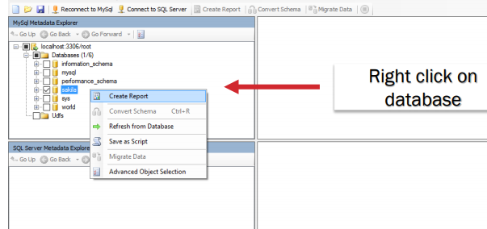
Assess: SQL Server Migration Assistant (SSMA)
Installing the SSMA for Oracle Client:
Double-click SSMAforOracle_8.1.0.msi.
On the 'Welcome' page, click Next.
If you do not have the prerequisites installed, a message will appear that indicates that you must first install required components. Make sure that you have installed all prerequisites, and then run the installation program again.
Read the End User License Agreement. If you agree to the terms, select "I accept the agreement" option and click Next.
On the 'Choose Setup Type' page, click Typical.
Click Install.
Installing the SSMA for Oracle Extension Pack :-
Installing the extension pack creates new database, sysdb, on the instance of SQL Server. The extension pack adds tables, stored procedures, and user-defined functions.

Slide 27
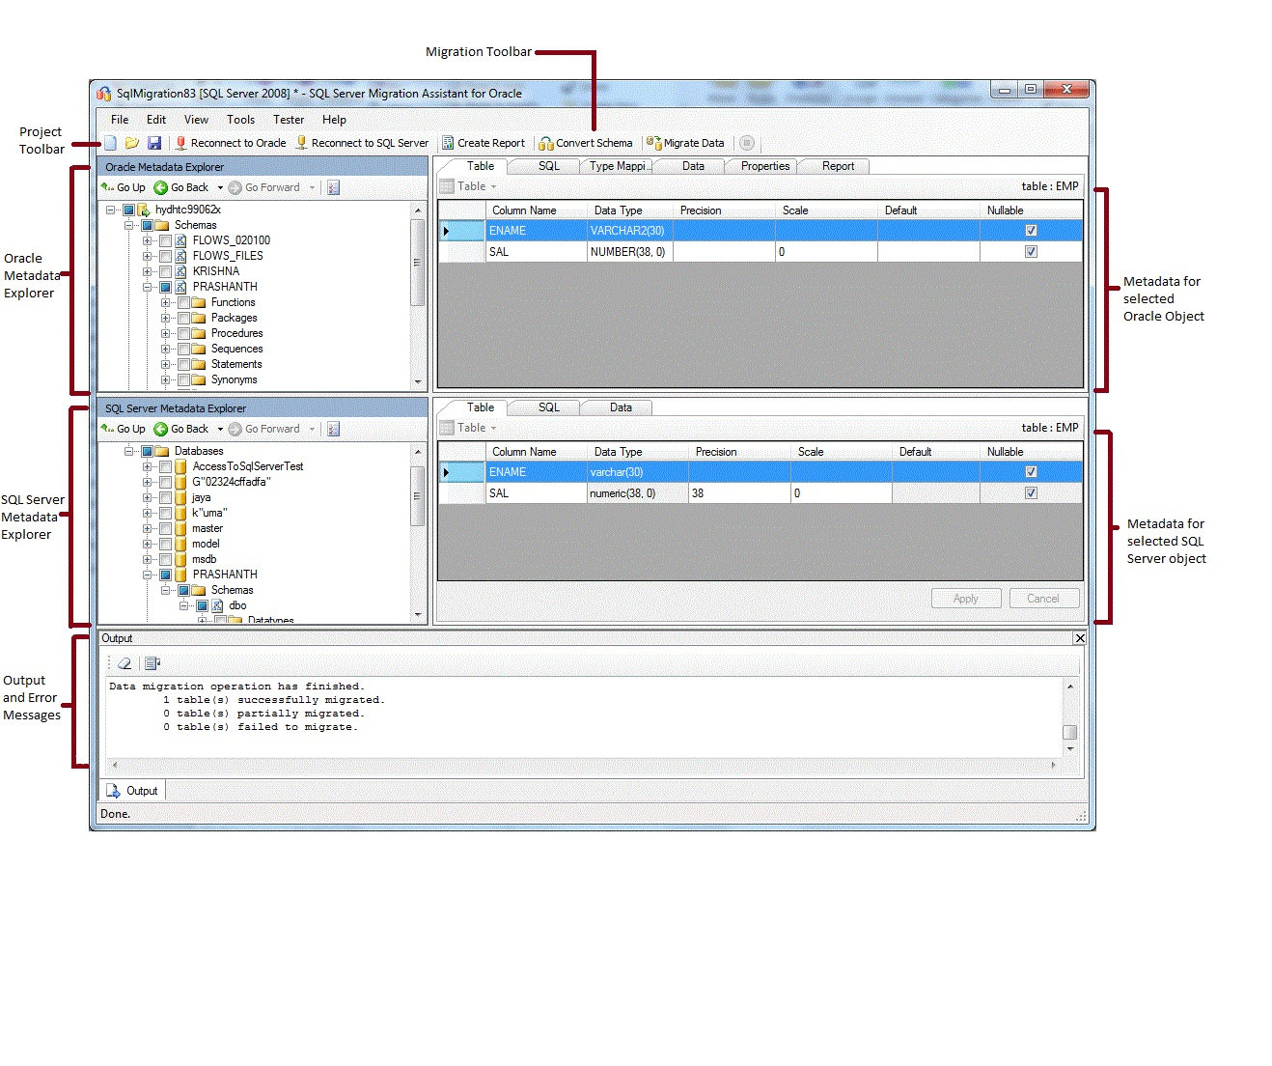
Assess: SQL Server Migration Assistant (SSMA)
Azure SQL Database
Expanded feature support
In-Memory OLTP
Columnstore
Row Level Security
Temporal
SSMA for Oracle User Interface
SSMA for Oracle
SSMA for Sybase
SSMA for DB2
SSMA for MySQL
SSMA for Access

Slide 28
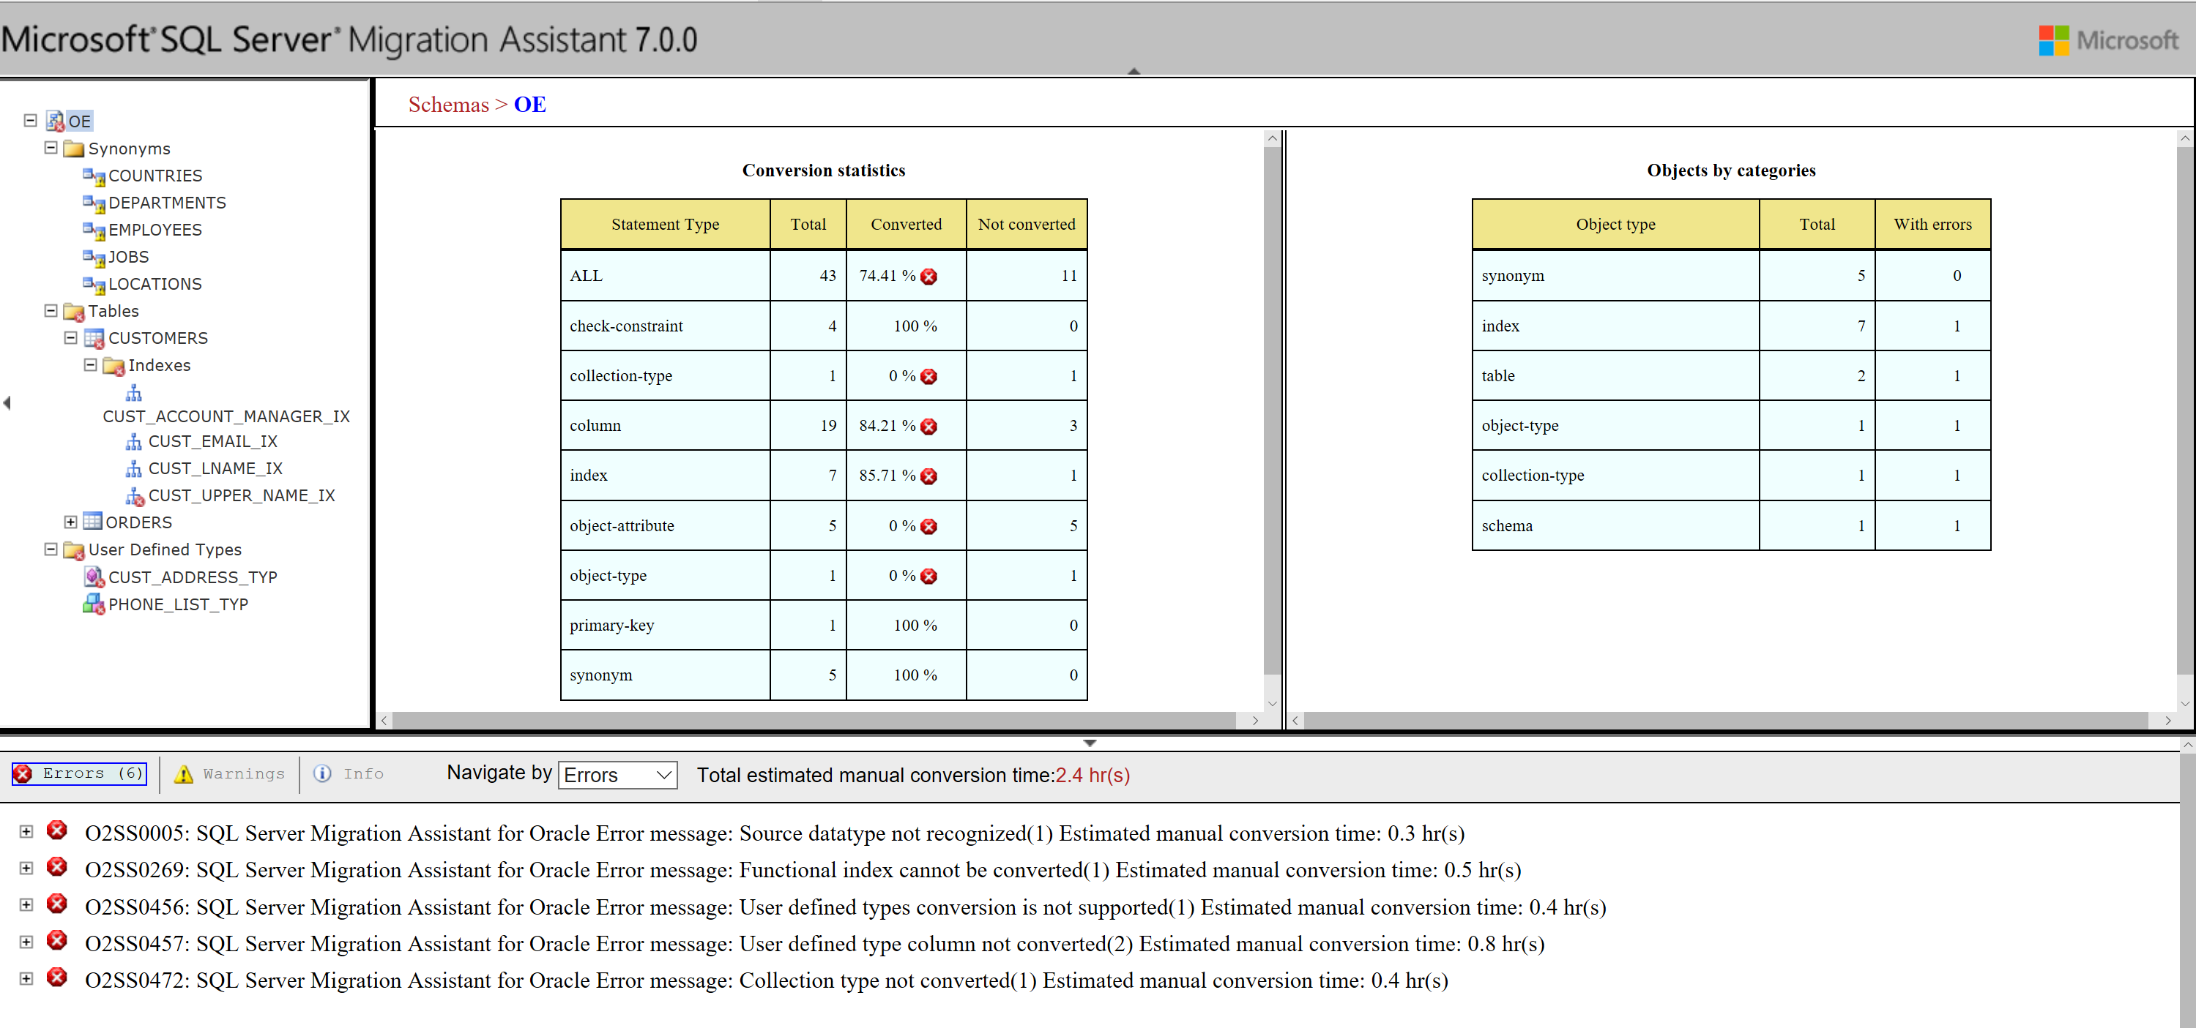
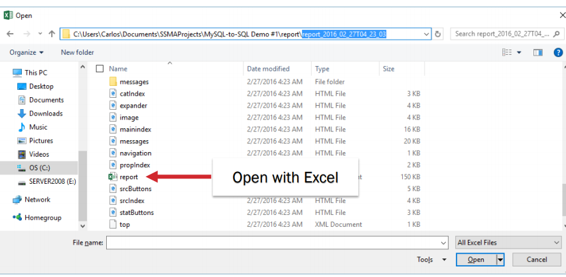
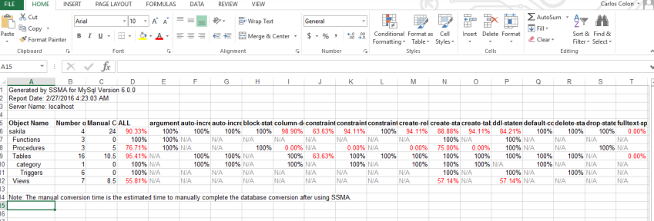
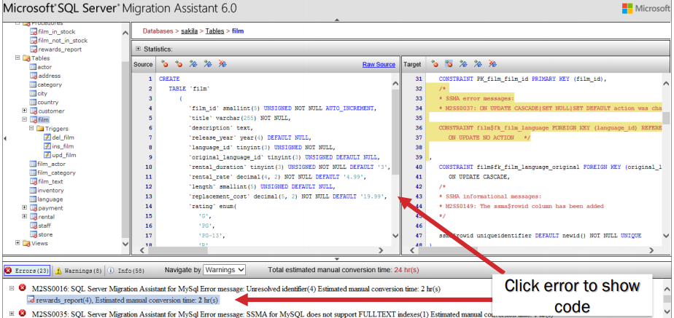
Assess: SSMA (Migration report)
Access Saved Report
Cost estimation
Conversion details

Slide 29
Plan
1 | Discover your infrastructure
2 | Map application dependencies
3 | Build move groups and design your migration plans
4 | Identify optimal cloud configuration for each workload to migrate to
5 | Design to land the migration
6 | Plan to expand
7 | HLD and LLD Solution design document

Slide 30




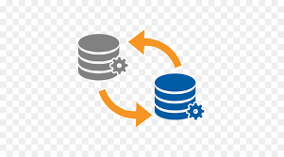



Plan
Extract design: how the data is extracted, held and verified
Migration design: how data is transformed into the target structure
Mapping rules: the details of the migration
Test overview: tools, reporting, structure and constraints
Unit test: unit test specification
Integration test: integration test specification
Recovery plan: recovery options for each stage of the migration
Go live plan: actions required to go live.
Discovery
Assessment
Schema Migration
Package/Procedure Migration
Functional Testing
Performance Testing
Application Migration
Data Migration

Slide 31
Deploy and Migrate
1. Migration Process
1. Opportunity
2. Discovery
3. Design
4. Migration integration and validation
5. operation and optimization
2. Migration Design
Pactera cloud tech experts utilize our data migration system
1. Tailored System Architecture
2. Transformation plan for migration
3. High Performance Solution
3. Migration Implementation and Tool
1. Heterogeneous Migration
2. Homogeneous Migration
3. Tool (SSMA and DMA from Azure)
4. Oracle to Azure SQL DB

Slide 32
Migration Methodology
SQL Server Migration Assistant (SSMA)
SQL Server Integration Services
Microsoft Assessment and Planning Toolkit (MAP)
SQL Server Migration Assistant (SSMA)
SQL Server Migration Assistant (SSMA)
SQL Server Integration Services
Migrate
Define
Assess
Design
Deploy
Remediate
Test

Slide 33
Azure SQL Database deployment options
SQL
Azure SQL Database
Single
Elastic Pool
Managed Instance
Database-scoped deployment option with predictable workload performance
Shared resource model optimized for greater efficiency of multi-tenant applications
Instance-scoped deployment option with high compatibility with SQL Server and full PaaS benefits
Best for apps that require resource guarantee at database level
Best for SaaS apps with multiple databases that can share resources at database level, achieving better cost efficiency
Best for modernization at scale with low friction and effort
Notes:
Introducing Azure SQL Database Managed Instance
SQL Database Managed Instance is an expansion of the existing SQL Database service designed to enable database migration to a fully-managed database service, without re-designing the application.
It’s important to note that Managed Instance isn’t a new service – it is a third deployment option within Azure SQL Database, sitting alongside single databases and elastic pools. As part of Azure SQL Database, Microsoft’s fully managed cloud database service, it inherits all its built-in features.
A SQL Database Managed Instance offers a simplified instance-scoped programming model that is like an on-premises SQL Server instance. The databases in a SQL Database Managed Instance share the resources allocated to the Managed Instance, and the Managed Instance also represents the management grouping for these databases. The emphasis of this offering is on high compatibility with the programming model of an on-premises SQL Server and out-of-box support for a large majority of SQL Server features and accompanying tools/services.
Each standalone database is assigned a certain amount of resources via performance tiers: Basic, Standard, and Premium. The emphasis of this offering focuses on a simplified database-scoped programming model and applications with a predictable pattern and relatively stable workload.
An elastic database pool is a shared resource model that enables higher resource utilization efficiency, and all the databases within an elastic pool share predefined resources within the same pool. The emphasis of this offering is on a simplified database-scoped programming model for multi-tenant SaaS apps. The workload pattern is well-defined and is highly cost-effective in multi-tenant scenarios. For ISVs with SaaS apps, the savings can be significant, in the hundreds of thousands of dollars or more.

Slide 34
Deploy: Deployment workflow
Read all from source
Write to destination
Record position
Prepare database
Migrate Flow, Test, Remediate
Read changes
Get last position
Process changes
Save current position
Schema migration
Data migration
Automatic schema conversion
SSMA (client or server)
Customize type mappings
SSIS (server)
Manual code conversion

Slide 35
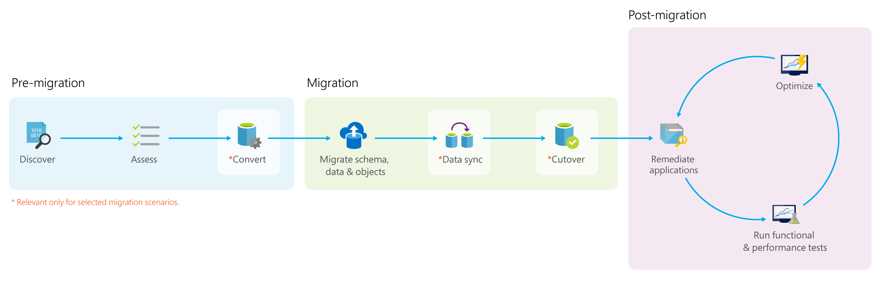
Migration process overview
Migrations should be approached with the same rigor and processes as a full software or hardware project – a solid methodology is required for success. When planning a database migration project, we recommend that you consider the process shown in the following graphic:
Connect to an Oracle database.
Connect to an instance of SQL Server.
Convert Oracle database objects to SQL Server syntax.
Load the objects into SQL Server.
Migrate data to SQL Server.

Slide 36
STAGE PHASE DESCRIPTION
Pre-migration:
Discover Inventory database assets, and application stack discovery.
Assess Assess workloads and fix recommendations.
Convert Convert the source schema to work in the target environment. This is only relevant for heterogeneous migrations.
Migration
Migrate schema, data, and objects Migrate the source schema, and then migrate the source data to the target.
Sync data Sync your target schema and data with the source. This is only relevant for minimal-downtime migrations.
Cutover Cut over from the source to the target environment. This is only relevant for minimal-downtime migrations.
Post-migration
Remediate applications Iteratively make any necessary changes to your applications.
Perform Tests Iteratively run functional and performance tests.
Optimize Based on the tests you performed, address any performance issues, and then retest to confirm the performance improvements.

Slide 37
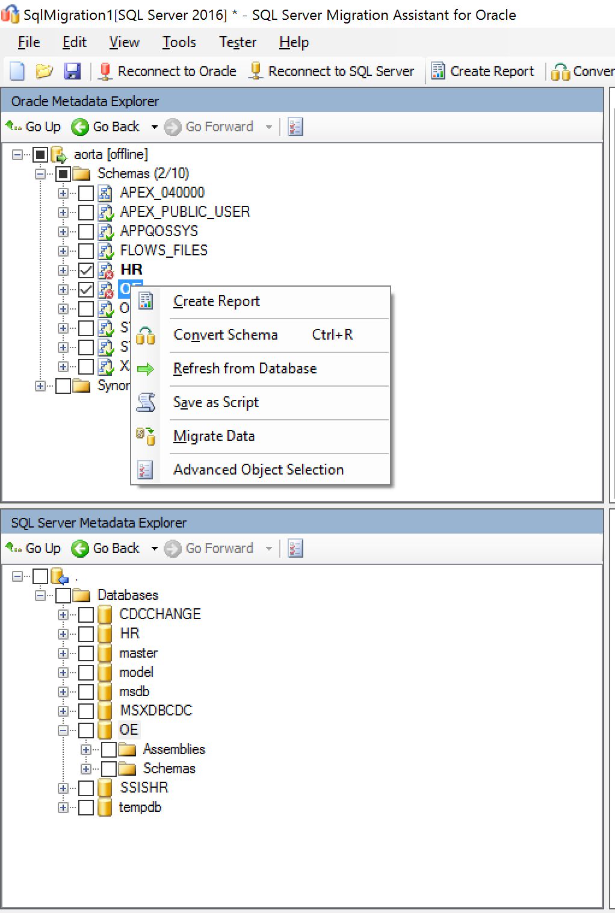
Migration Tool: SSMA (Migration workflow)
Project-based migration
Online database explorer
Schema migration
Data migration
Platform extensions

Slide 38
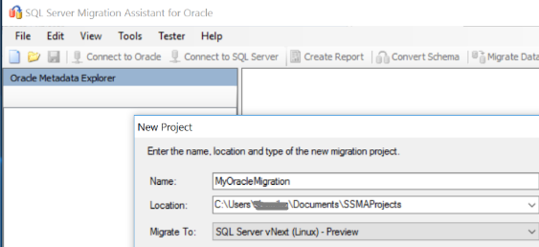
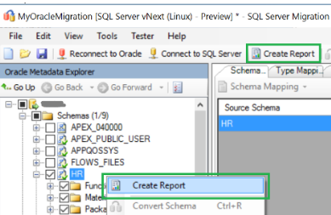
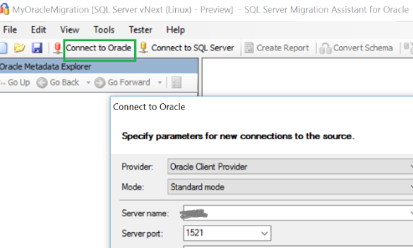
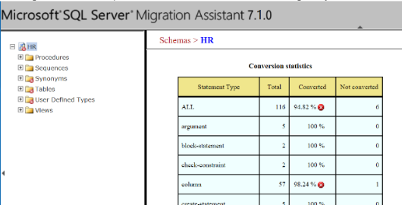
Migrate :- Migrate Oracle DB to Azure SQL Database
By using the SQL Server Migration Assistant (SSMA) for Oracle, you can review database objects and data, assess databases for migration, migrate database objects to SQL Server, and then migrate data to SQL Server.
1. Pre-migration
1. Assess the source database
3. Create the conversion report by selecting the Oracle schema
2. Connect to the Oracle server
4.Analyze this report to understand conversion issues and its cause.
Cont..
Notes:
https://techcommunity.microsoft.com/t5/Microsoft-Data-Migration/Migrate-your-Oracle-database-to-Azure-SQL-Database-Managed/ba-p/368750

Slide 39
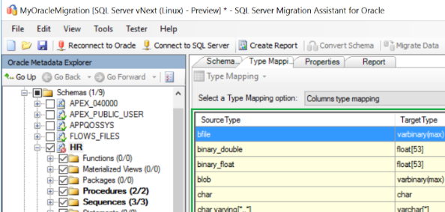
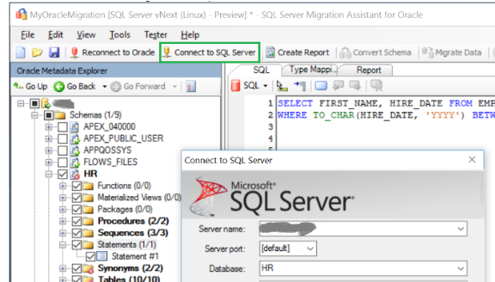
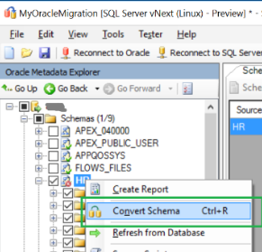
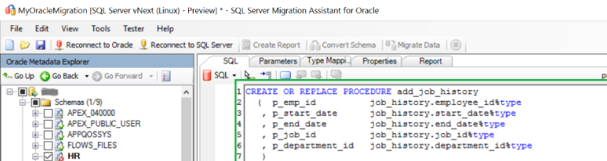
Migrate Oracle to Azure SQL Database
5. Perform schema conversion
6. Converting and moving the schema to Azure SQL Database, connect to the SQL instance by providing
7.Convert the schema by choosing "Convert Schema"
8.Compare and review the structure of the schema to identify potential problems.
Notes:
Data sync and Cutover:
With minimal-downtime migrations, the source you are migrating continues to change, drifting from the target in terms of data and schema, after the one-time migration occurs. During the Data sync phase, you need to ensure that all changes in the source are captured and applied to the target in near real time. After you verify that all changes in source have been applied to the target, you can cutover from the source to the target environment.
The Azure Database Migration Service does not yet support minimal-downtime migrations for this scenario, so the Data sync and Cutover phases are not currently applicable.

Slide 40
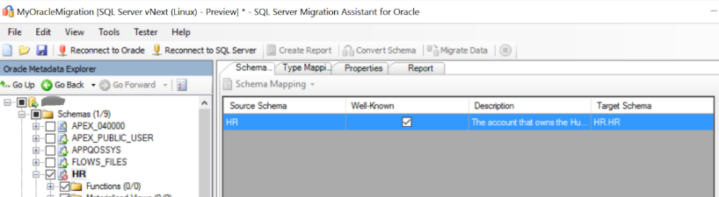
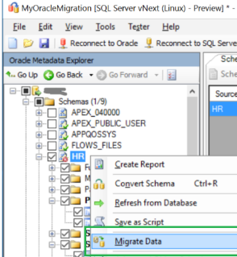
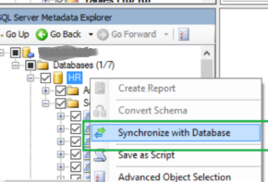
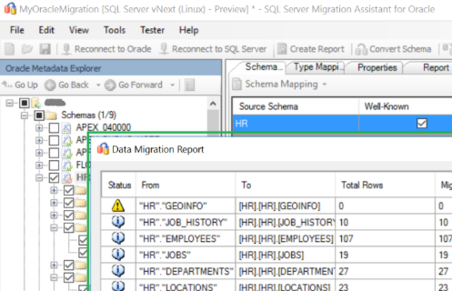
Migrate Oracle DB to Azure SQL Database
2. Migrate schema and data
After have completed assessing your databases and addressing any discrepancies, the next step is to execute the migration process. Migration involves two steps – publishing the schema and migrating the data. SSMA for Oracle is the correct tool to use for this process.
1. Publish the schema to Azure SQL Database.
2. Migrate data to Azure SQL Database
3. Data Migration report
Cont..
Notes:
Publish the schema to Azure SQL Database:
a. After schema conversion you can save this project locally for an offline schema remediation exercise. You can do so by choosing "Save Project" from the "File" menu. This gives you an opportunity to evaluate the source and target schemas offline and perform remediation before you can publish the schema to Azure SQL Database.
b. To Publish the schema, select the database from the "Databases" node in the "SQL Azure Metadata Explorer" and choose "Synchronize with Database" from the right-click menu options
Migrate data to Azure SQL Database.
a. After publishing the schema to the Azure SQL instance, select the Oracle schema from the "Oracle Metadata Explorer” and choose "Migrate Data" from the right-click menu options or the menu bar on the top.
b. At this step you will be required to provide connection details for Oracle and Azure SQL in their respective connection dialogs to migrate the data.

Slide 41
Deploy: Change data capture (CDC)
CDC with Oracle
Retrieves incremental changes from your source
Reducing the amount of data you move reduces processing time
Automatic tracking of changes
Based on log readers
No need to modify source schema
Rollup of net changes processing
Key for data warehousing and migration scenarios
CDC components work with SQL and Oracle
Looks the same for the SSIS components
Requires installation of two additional components included with SQL Server:
Oracle CDC Service
Oracle CDC Designer

Slide 42




How CDC for Oracle works
How CDC for Oracle works
SSIS CDC Package
Must be in ARCHIVELOG mode
CDC Designer
Oracle
SQL Server
Database
LogMiner
Mirror Tables
CDC Tables
CDC Service

Slide 43
Validate
Migration Verification
1. Login and Authentication
2. Real time Validation
1. Check consistency
2. Security
3. Methods Application
4. Process
5. Accuracy

Slide 44
Validate: Migrate Oracle DB to Azure SQL Database
3. Post-migration
After successfully completed the Migration stage, we need to go through a series of post-migration tasks to ensure that everything is functioning as smoothly and efficiently as possible.
Remediate applications.
After the data is migrated to the target environment, all the applications that formerly consumed the source need to start consuming the target. Accomplishing this will in some cases require changes to the applications.
Perform tests
To test database migration, we need to use SQL queries. we must create the validation queries to run against both the source and the target databases. We validation queries should cover the scope you have defined.
2. Set up test environment.
The test environment should contain a copy of the source database and the target database. Be sure to isolate the test environment
.
Run validation tests.
Run the validation tests against the source and the target, and then analyze the results.
.
4. Run performance tests.
Run performance test against the source and the target, and then analyze and compare the results.
Develop validation tests.
Notes:
Develop validation tests. To test database migration, you need to use SQL queries. You must create the validation queries to run against both the source and the target databases. Your validation queries should cover the scope you have defined.
Set up test environment. The test environment should contain a copy of the source database and the target database. Be sure to isolate the test environment.
Run validation tests. Run the validation tests against the source and the target, and then analyze the results.
Run performance tests. Run performance test against the source and the target, and then analyze and compare the results

Slide 45
Monitor and Manage
1 | Right size cloud workloads
2 | Azure Monitor
3 | Manage Cloud Cost
4 | Azure SQL Analytics
5 | Performance
6 | Accurately plan capacity
7 | Analyze costs, filter billing data and usage

Slide 46

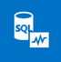
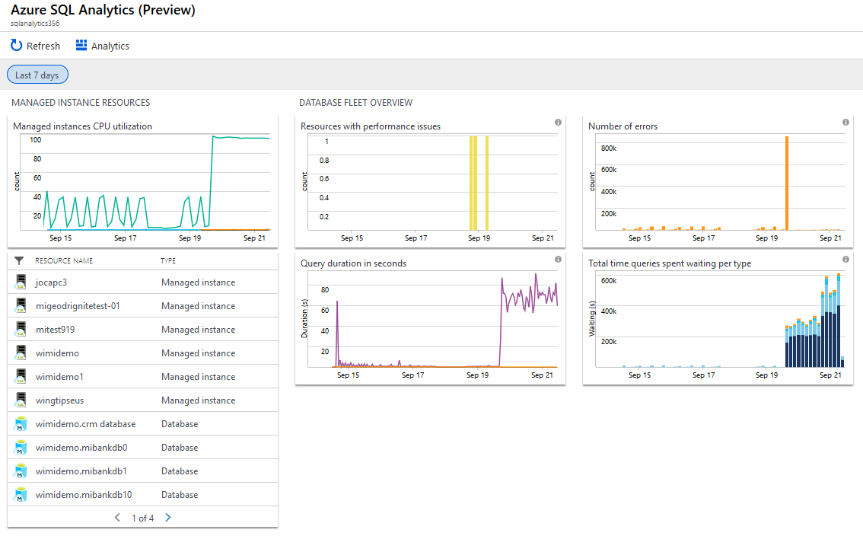

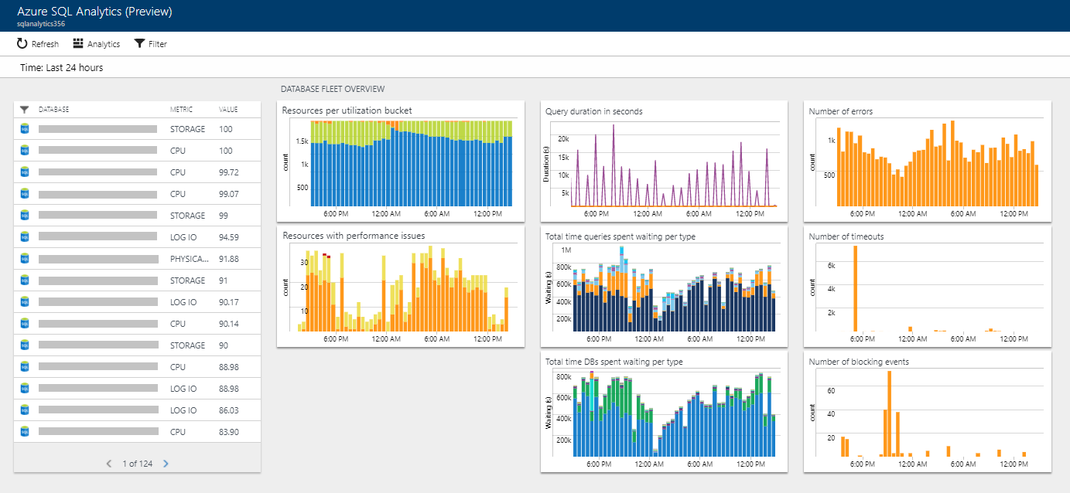
Monitor and Manage
Azure Monitor
Azure SQL Analytics
Managed Instance and databases in Managed Instance view
Advanced analytics and machine learning to monitor application performance
Proactively identify issues and automatically respond to alerts
Integrate with and enhance your operational workflow
Performance
Notes:
Azure Monitor:
Azure Monitor now integrates the capabilities of Log Analytics and Application Insights for powerful, end-to-end monitoring of your applications. You can also keep using Log Analytics and Application Insights on their own.
Manage cloud costs
Manage your cloud spend with transparency and accuracy using Azure Cost Management. Use this solution to allocate, trim and monitor cloud costs to build toward your next investment.

Slide 47

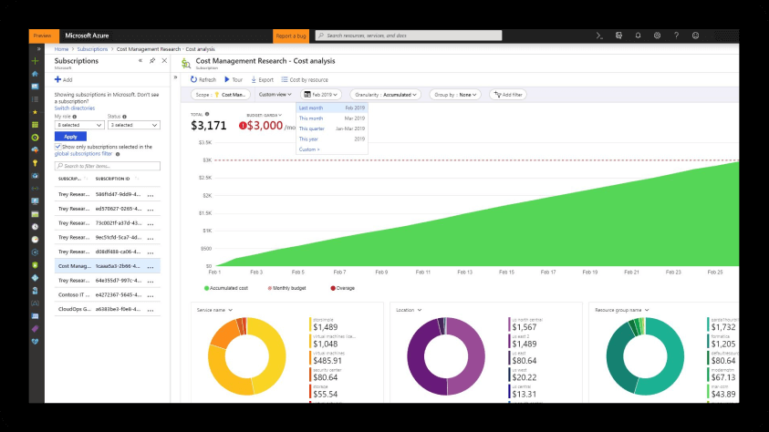
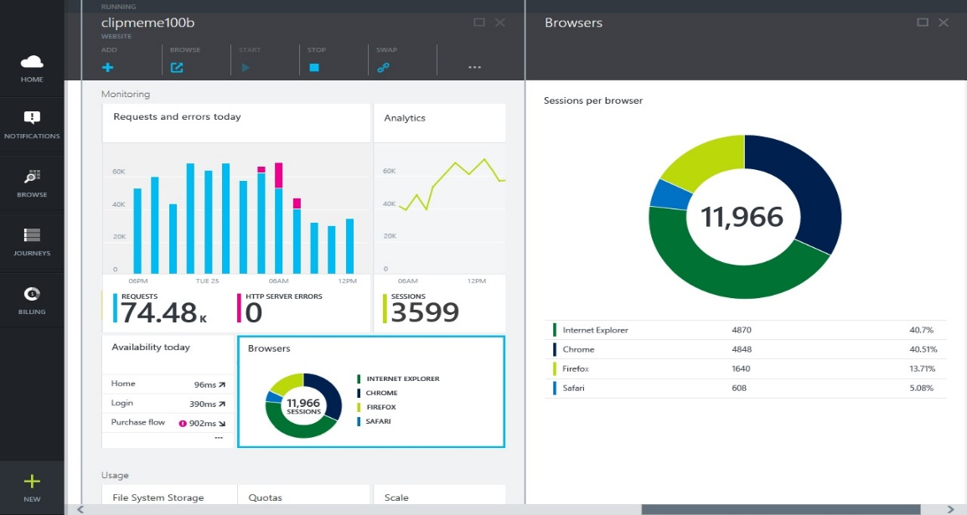
Manage cloud costs
Track resource usage
Optimize cloud efficiency
Reporting | Report on cost and usage
Data enrichment | Categorise by resource tags
Budgets | Create and manage cost and usage budgets
Alerting | Create alerts on cost and usage budgets
Recommendations | Eliminate idle cloud resources
 | Right-size cloud resources
Notes:
Azure Monitor:
Azure Monitor now integrates the capabilities of Log Analytics and Application Insights for powerful, end-to-end monitoring of your applications. You can also keep using Log Analytics and Application Insights on their own.
Manage cloud costs
Manage your cloud spend with transparency and accuracy using Azure Cost Management. Use this solution to allocate, trim and monitor cloud costs to build toward your next investment.

Slide 48
Appendix

Slide 49





SECURITY BEST PRACTICES INFUSED INTO OUR PROCESS
Data Governance & SDLC
Risk Management
The business data used across different projects is in compliance with the corporate data privacy regulations and external regulatory requirements. Secure coding practices are followed across all projects
Risk Management procedures are formalized and implemented to reduce the risk impact through unified risk identification, analysis and treatment
ISO27001 Implementation
General Data Protection Regulation
All the Chinese sites are ISO27001 certified. Redmond (USA) and Hyderabad
(India) sites are in the process to get certified in the next 6 months
Data protection regulations such as GDPR are implemented with strong security and privacy controls in place
HIPAA Compliance
Infrastructure Security
Adequate physical and administrative environment is setup in compliance with HIPAA requirements
Required infrastructure controls related to network security and information security are setup to be in compliance with client and regulatory requirements

Slide 50
Case Study

Slide 51


“We were able to migrate an app with zero friction to a Managed Instance with features like CLR and SQL Agent just working. Database Migration Service will be crucial for pulling off migrations like this at scale.”
--Sankar G. Prayaga, Lead Engineer, EY

Slide 52


“SQL Managed Instance is that happy medium we were looking for. We needed the power and compatibility of SQL Server, but without the management overhead and cost that comes with running VMs 24x7. Not only will we get that power and ease of management, we’ll also be able to use the Azure Hybrid Use benefit which allows us to use our existing SQL Server licensing through Software Assurance. Developing, deploying and managing our application is getting a whole lot easier and cheaper with Azure and SQL Managed Instance.”
--Robert Shurbet, Pivot Technology Solutions

Slide 53

“We deploy our SQL Server schema elements into a Managed Instance and we point the application via connection string change directly over to the Managed Instance.”
--Eric Fleischman, Vice-President and Chief Architect

